Slide 1
Pipelining
Morteza Nikooghadam
Chapter 9

Slide 2
Outline
Today’s topic
  Pipelining is an implementation technique in which multiple instructions are overlapped in execution
  Subset of MIPS instructions
    lw, sw, and, or, add, sub, slt, beq
Outline
  Pipeline high-level introduction
    Stages, hazards
  Pipelined datapath and control design
Pipeline
Notes:
So where are in in the overall scheme of things.
Well, we just finished designing the processor’s datapath.
Now I am going to show you how to design the control for the datapath.
+1 = 7 min. (X:47)

Slide 3
Pipelining is Natural!
Laundry example
  Ann, Brian, Cathy, Dave
  each has one load of clothes
  to wash, dry, and fold
  Washer takes 30 minutes
  Dryer takes 40 minutes
  “Folder” takes 20 minutes
A
B
C
D
Pipeline

Slide 4
Sequential Laundry
6 PM
7
8
9
10
11
Midnight
Time
30
40
20
30
40
20
30
40
20
30
40
20
T
a
s
k
O
r
d
e
r
A
B
C
D
Sequential laundry takes 6 hours for 4 loads
If they learned pipelining, how long would laundry take?
Pipeline

Slide 5
Pipelined Laundry
6 PM
7
8
9
10
11
Midnight
Time
30
40
40
40
40
20
T
a
s
k
O
r
d
e
r
A
B
C
D
Start work ASAP
Pipelined laundry takes 3.5 hours for 4 loads
Pipeline

Slide 6
Pipelining Lessons (I)
6 PM
Multiple tasks operating simultaneously using different resources
Pipelining doesn’t help latency of single task, it helps throughput of entire workload
Pipeline rate is limited by slowest pipeline stage
  Unbalanced lengths of pipeline stages reduces speedup
7
8
9
Time
30
40
40
40
40
20
T
a
s
k
O
r
d
e
r
A
B
C
D
Pipeline

Slide 7
Pipelining Lessons (II)
6 PM
Potential speedup = Number pipeline stages
Time to “fill” pipeline and time to “drain” it reduces speedup- startup and wind down
Stall for dependencies
7
8
9
Time
30
40
40
40
40
20
T
a
s
k
O
r
d
e
r
A
B
C
D
Pipeline

Slide 8
Five Stages of Workload
Cycle 1
Cycle 2
Cycle 3
Cycle 4
Cycle 5
Load
Ifetch
Reg/Dec
Exec
Mem
Wr
Ifetch: Instruction Fetch
  Fetch the instruction from the Instruction Memory
Reg/Dec: Registers Fetch and Instruction Decode
Exec: Calculate the memory address
Mem: Read the data from the Data Memory
Wr: Write the data back to the register file
Pipeline
Notes:
As shown here, each of these five steps will take one clock cycle to complete.
And in pipeline terminology, each step is referred to as one stage of the pipeline.
+1 = 8 min. (X:48)

Slide 9
Single Cycle, Multi-Cycle, Pipeline
Cycle 1
Cycle 2
Clk
Single Cycle Implementation:
Load
Store
Waste
Cycle 1
Cycle 2
Cycle 3
Cycle 4
Cycle 5
Cycle 6
Cycle 7
Cycle 8
Cycle 9
Cycle 10
Clk
Multiple Cycle Implementation:
Load
Store
R-type
Ifetch
Reg
Exec
Mem
Wr
Ifetch
Reg
Exec
Mem
Ifetch
Pipeline Implementation:
Load
Ifetch
Reg
Exec
Mem
Wr
Store
Ifetch
Reg
Exec
Mem
Wr
R-type
Ifetch
Reg
Exec
Mem
Wr
Pipeline
Notes:
Here are the timing diagrams showing the differences between the single cycle, multiple cycle, and pipeline implementations.
For example, in the pipeline implementation, we can finish executing the Load, Store, and R-type instruction sequence in seven cycles.
In the multiple clock cycle implementation, however, we cannot start executing the store until Cycle 6 because we must wait for the load instruction to complete.
Similarly, we cannot start the execution of the R-type instruction until the store instruction has completed its execution in Cycle 9.
In the Single Cycle implementation, the cycle time is set to accommodate the longest instruction, the Load instruction.
Consequently, the cycle time for the Single Cycle implementation can be five times longer than the multiple cycle implementation.
But may be more importantly, since the cycle time has to be long enough for the load instruction, it is too long for the store instruction so the last part of the cycle here is wasted.
+2 = 77 min. (X:57)

Slide 10
Why Pipeline? (Performance)
Suppose we execute 100 instructions
Single cycle machine
  45 (ns/cycle) x 1 (CPI) x 100 (inst) = 4500 ns
Multicycle machine
  10 (ns/cycle) x 4.4 (CPI) (due to inst mix) x 100 (inst) = 4400 ns
Ideal pipelined machine
  10 (ns/cycle) x (1 (CPI) x 100 (inst) + 4 cycle drain) = 1040 ns
Pipeline

Slide 11
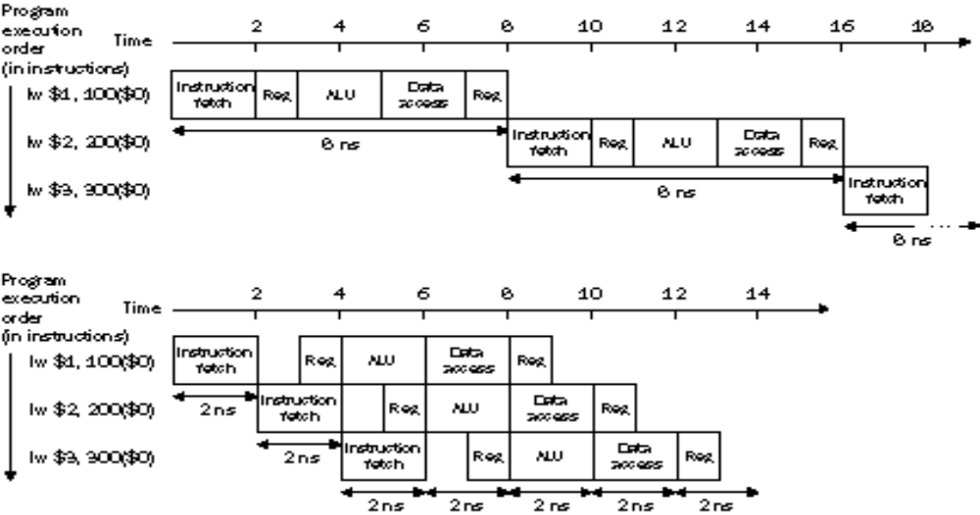
Pipelining Throughput
Ideal speedup is no. of stages in the pipeline; in practice:
  Pipeline stage time are limited by the slowest resource, either the ALU or memory access
  Fill and drain time
Pipeline

Slide 12
Why Pipeline? (Resource)
Time (clock cycles)
I
n
s
t
r.
O
r
d
e
r
Inst 0
Im
Reg
ALU
Dm
Reg
Inst 1
Im
Reg
ALU
Dm
Reg
Inst 2
Im
Reg
ALU
Dm
Reg
Inst 3
Im
Reg
ALU
Dm
Reg
Inst 4
Im
Reg
ALU
Dm
Reg
Pipeline
Notes:
Because resources are there

Slide 13
Pipeline Hazards
Hazards prevent next instruction from executing during its designated clock cycle
  Structural hazards: attempt to use the same resource two different ways at the same time
    E.g., combined washer/dryer would be a structural hazard or folder busy doing something else (watching TV)
    One memory port
  Data hazards: attempt to use data before it is ready
    E.g., one sock of pair in dryer and one in washer; can’t fold until you get sock from washer through dryer
    Instruction depends on result of prior instruction still in the pipeline
  Control hazards: attempt to make a decision before condition is evaluated
    Branch instructions
Pipeline
Notes:
E.g., washing football uniforms and need to get proper detergent level; need to see after dryer before next load in
Can always resolve hazards by waiting
pipeline control must detect the hazard
take action (or delay action) to resolve hazards

Slide 14
Structural Hazard: One Memory
Time (clock cycles)
I
n
s
t
r.
O
r
d
e
r
Load
Mem
Reg
ALU
Mem
Reg
Instr 1
Mem
Reg
ALU
Mem
Reg
Instr 2
Mem
Reg
ALU
Mem
Reg
Instr 3
Mem
Reg
ALU
Mem
Reg
Instr 4
Mem
Reg
ALU
Mem
Reg
Solution 1: add more HW
Hazards can always be resolved by waiting
Pipeline

Slide 15
Structural Hazard: One Memory
Time (clock cycles)
I
n
s
t
r.
O
r
d
e
r
Load
Mem
Reg
ALU
Mem
Reg
Instr 1
Mem
Reg
ALU
Mem
Reg
Instr 2
Mem
Reg
ALU
Mem
Reg
stall
Bubble
Bubble
Bubble
Bubble
Bubble
Instr 3
Mem
Reg
ALU
Mem
Reg
Hazards can always be resolved by waiting
Pipeline

Slide 16
Data Hazard Example
Data hazard: an instruction depends on the result of a previous instruction still in the pipeline
add r1 ,r2,r3
sub r4, r1 ,r3
and r6, r1 ,r7
or r8, r1 ,r9
xor r10, r1 ,r11
Pipeline

Slide 17
Data Hazard Example
Dependences backward in time are hazards
Compilers can help, but it gets messy and difficult
Time (clock cycles)
IF
ID/RF
EX
MEM
WB
add r1,r2,r3
Im
Reg
ALU
Dm
Reg
I
n
s
t
r.
O
r
d
e
r
sub r4,r1,r3
Im
Reg
ALU
Dm
Reg
and r6,r1,r7
Im
Reg
ALU
Dm
Reg
or r8,r1,r9
Im
Reg
ALU
Dm
Reg
xor r10,r1,r11
Im
Reg
ALU
Dm
Reg
Pipeline

Slide 18
Data Hazard Solution
Time (clock cycles)
IF
ID/RF
EX
MEM
WB
add r1,r2,r3
Im
Reg
ALU
Dm
Reg
I
n
s
t
r.
O
r
d
e
r
sub r4,r1,r3
Im
Reg
ALU
Dm
Reg
and r6,r1,r7
Im
Reg
ALU
Dm
Reg
or r8,r1,r9
Im
Reg
ALU
Dm
Reg
xor r10,r1,r11
Im
Reg
ALU
Dm
Reg
Solution : “forward” result from one stage to another
Pipeline

Slide 19
Data Hazard Even with Forwarding
Time (clock cycles)
IF
ID/RF
EX
MEM
WB
lw r1,0(r2)
Im
Reg
ALU
Dm
Reg
sub r4,r1,r3
Im
Reg
ALU
Dm
Reg
Can’t go back in time! Must delay/stall instruction dependent on loads
Pipeline

Slide 20
Data Hazard Even with Forwarding
Time (clock cycles)
IF
ID/RF
EX
MEM
WB
lw r1,0(r2)
Im
Reg
ALU
Dm
Reg
sub r4,r1,r3
Stall
Im
Reg
ALU
Dm
Reg
Must delay/stall instruction dependent on loads
Sometimes the instruction sequence can be reordered to avoid pipeline stalls
Pipeline

Slide 21
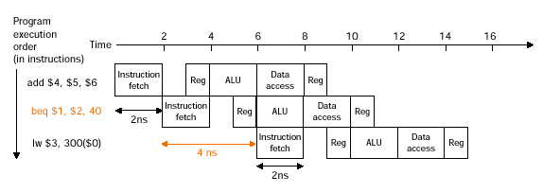
Control Hazards
Branch instructions may change execution flow
  Suppose we can do decoding/branch decision/branch target computation at stage 2
    Still introduce 1-cycle stall
    Implementation details later
Pipeline

Slide 22
Control Hazard Solution: Predict
Predict: guess one direction then back up if wrong
Impact: 0 lost cycles per branch instruction if right, 1 if wrong
  Need to “Squash” and restart following instruction if wrong
Prediction scheme
  Random prediction: correct ­ 50% of time
  History-based prediction: correct­ 90% of time
Pipeline
Notes:
Produce CPI on branch of (1 *.5 + 2 * .5) = 1.5
Total CPI might then be: 1.5 * .2 + 1 * .8 = 1.1 (20% branch)

Slide 23
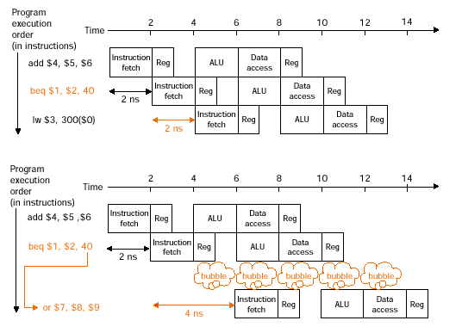
Control Hazard Solution: Predict
Pipeline

Slide 24
Pipeline Overview Summary
Pipelining is a fundamental concept
  Multiple steps using distinct resources
Utilize capabilities of the datapath by pipelined instruction processing
  Start next instruction while working on the current one
  Detect and resolve hazards
    Structural hazards, data hazards, control hazards
    All hazards can be solved by stall
    Other approaches: forwarding, prediction, reordering
In modern processors, what really makes it hard:
  Exception handling
  Out-of-order execution
Next: datapath design for pipeling
Pipeline

Slide 25
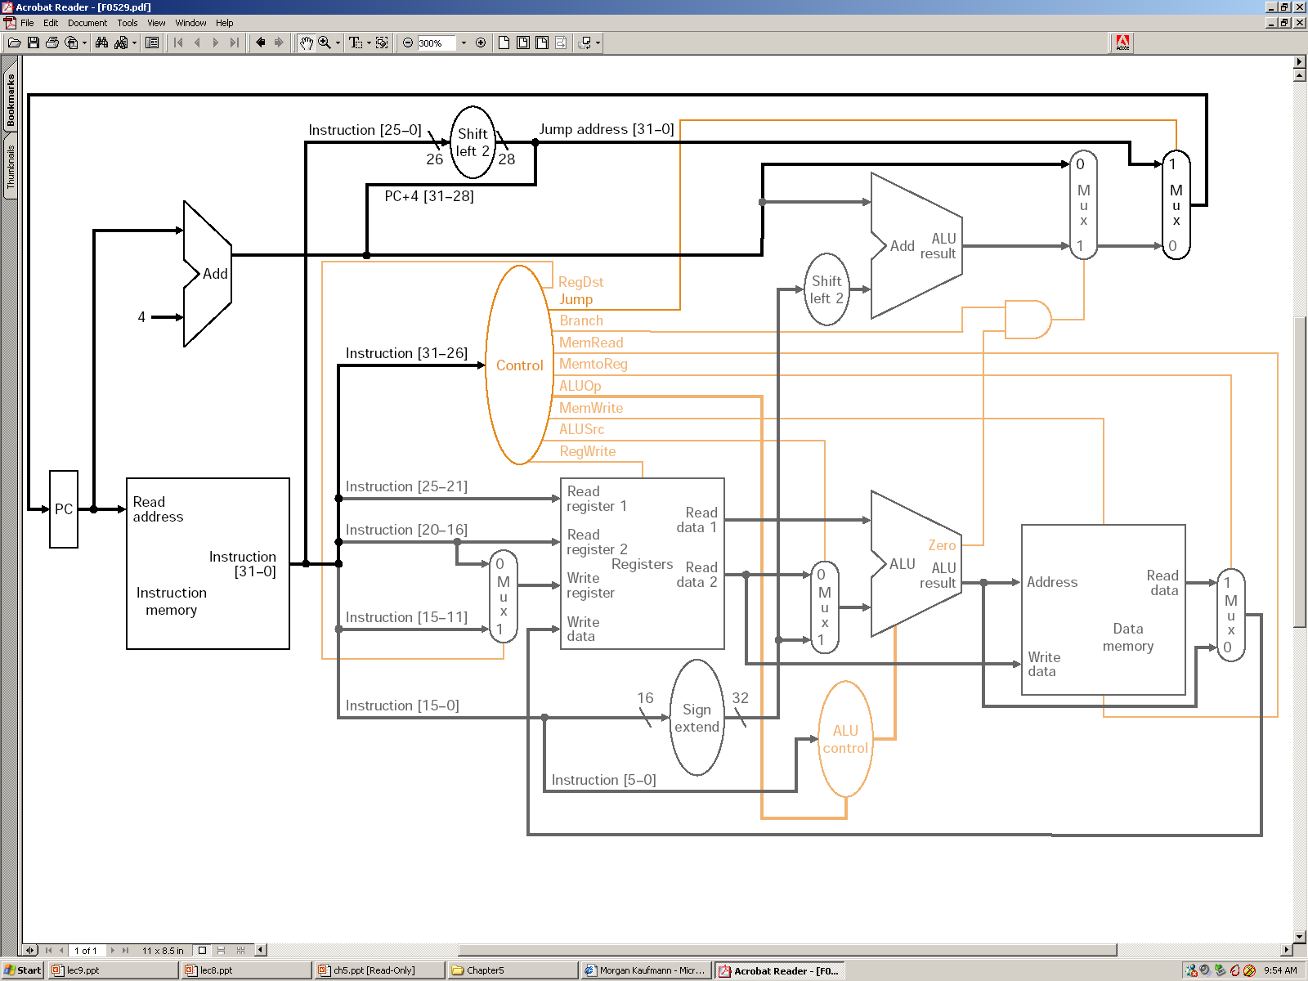
Single Cycle Datapath
Pipeline

Slide 26
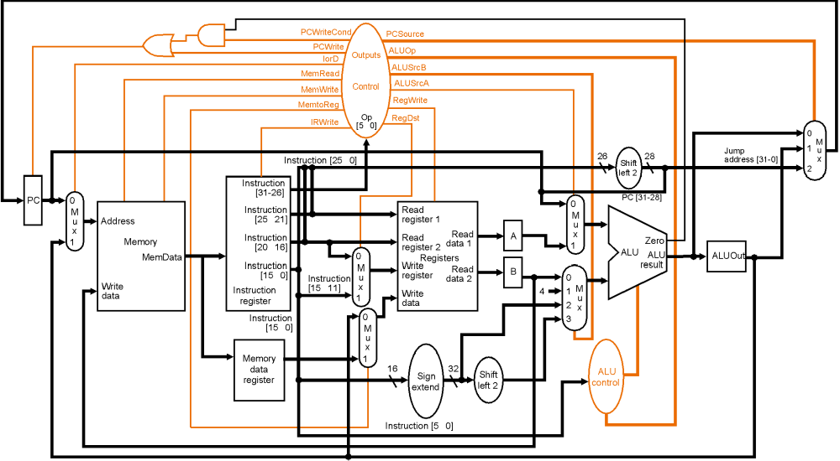
Multi Cycle Datapath
Divide the work into stages; internal registers
Pipeline

Slide 27
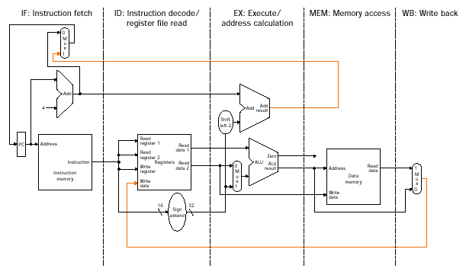
Single-Cycle Pipeline Datagram
What do we need to add to split the datapath into stages?
Pipeline

Slide 28
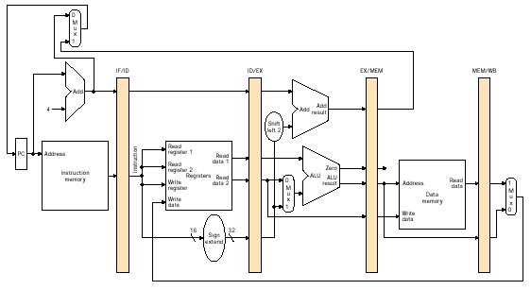
Pipelined Datapath
64
128
97
64
How many bits stored in each pipeline register?
Pipeline

Slide 29
Observations
5-stage pipeline
  IF, ID, EX, MEM, WB
Left-to-right flow of instructions
  Instructions and data move generally from left to right
  Two exceptions: WB stage and the selection of PC
    May lead to data hazards and control hazards
Why there is no pipeline register at the end of the WB stage?
  Last stage must update either register file, or memory, or PC
Pipeline

Slide 30
Pipelining the Load Instruction
Cycle 1
Cycle 2
Cycle 3
Cycle 4
Cycle 5
Cycle 6
Cycle 7
Clock
1st lw
Ifetch
Reg/Dec
Exec
Mem
Wr
2nd lw
Ifetch
Reg/Dec
Exec
Mem
Wr
3rd lw
Ifetch
Reg/Dec
Exec
Mem
Wr
The five independent functional units in the pipeline datapath are:
  Instruction Memory for the IF stage
  Register File’s Read Ports (busA and busB) for the ID stage
  ALU for the EXE stage
  Data Memory for the MEM stage
  Register File’s Write port (bus W) for the WB stage
Pipeline
Notes:
For the load instructions, the five independent functional units in the pipeline datapath are:
(a) Instruction Memory for the Ifetch stage.
(b) Register File’s Read ports for the Reg/Decode stage.
(c) ALU for the Exec stage. (d) Data memory for the Mem stage.
(e) And finally Register File’s write port for the Write Back stage.
Notice that I have treat Register File’s read and write ports as separate functional units because the register file we have allows us to read and write at the same time.
Notice that as soon as the 1st load finishes its Ifetch stage, it no longer needs the Instruction Memory. Consequently, the 2nd load can start using the Instruction Memory (2nd Ifetch).
Furthermore, since each functional unit is only used ONCE per instruction, we will not have any conflict down the pipeline (Exec-Ifet, Mem-Exec, Wr-Mem) either.
I will show you the interaction between instructions in the pipelined datapath later. But for now, I want to point out the performance advantages of pipelining.
If these 3 load instructions are to be executed by the multiple cycle processor, it will take 15 cycles. But with pipelining, it only takes 7 cycles. This (7 cycles), however, is not the best way to look at the performance advantages of pipelining.
A better way to look at this is that we have one instruction enters the pipeline every cycle so we will have one instruction coming out of the pipeline (Wr stages) every cycle.
Consequently, the “effective” (or average) number of cycles per instruction is now ONE even though it takes a total of 5 cycles to complete each instruction.
+3 = 14 min. (X:54)

Slide 31
The Four Stages of R-type
Cycle 1
Cycle 2
Cycle 3
Cycle 4
R-type
Ifetch
Reg/Dec
Exec
Wr
IF: Instruction Fetch
  Fetch the instruction from the Instruction Memory
ID: Registers Fetch and Instruction Decode
EXE: ALU operates on the two register operands
WB: Write the ALU output back to the register file
Pipeline
Notes:
Well, so far so good. Let’s take a look at the R-type instructions.
The R-type instruction does NOT access data memory so it only takes four clock cycles, or in our new pipeline terminology, four stages to complete.
The Ifetch and Reg/Dec stages are identical to the Load instructions. Well they have to be because at this point, we do not know we have a R-type instruction yet.
Instead of calculating the effective address during the Exec stage, the R-type instruction will use the ALU to operate on the register operands.
The result of this ALU operation is written back to the register file during the Wr back stage.
+1 = 15 min. (55)

Slide 32
Pipelining R-type and Load Instruction
Cycle 1
Cycle 2
Cycle 3
Cycle 4
Cycle 5
Cycle 6
Cycle 7
Cycle 8
Cycle 9
Clock
R-type
Ifetch
Reg/Dec
Exec
Wr
Oops! We have a problem!
R-type
Ifetch
Reg/Dec
Exec
Wr
Load
Ifetch
Reg/Dec
Exec
Mem
Wr
R-type
Ifetch
Reg/Dec
Exec
Wr
R-type
Ifetch
Reg/Dec
Exec
Wr
We have pipeline conflict or structural hazard:
  Two instructions try to write to the register file at the same time!
  Only one write port
Pipeline
Notes:
What happened if we try to pipeline the R-type instructions with the Load instructions?
Well, we have a problem here!!!
We end up having two instructions trying to write to the register file at the same time!
Why do we have this problem (the write “bubble”)?
Well, the reason for this problem is that there is something I have not yet told you.
+1 = 16 min. (X:56)

Slide 33
Important Observation
Each functional unit can only be used once per instruction
Each functional unit must be used at the same stage for all instructions
Delay R-type’s register write by one cycle:
  Now R-type instructions also use Reg File’s write port at Stage 5
  Mem stage is a NO-OP stage: nothing is being done
1
2
3
4
5
R-type
Ifetch
Reg/Dec
Exec
Mem
Wr
Store
Ifetch
Reg/Dec
Exec
Mem
Wr
Beq
Ifetch
Reg/Dec
Exec
Mem
Wr
Pipeline
Notes:
I already told you that in order for pipeline to work perfectly, each functional unit can ONLY be used once per instruction.
What I have not told you is that this (1st bullet) is a necessary but NOT sufficient condition for pipeline to work.
The other condition to prevent pipeline hiccup is that each functional unit must be used at the same stage for all instructions.
For example here, the load instruction uses the Register File’s Wr port during its 5th stage but the R-type instruction right now will use the Register File’s port during its 4th stage.
This (5 versus 4) is what caused our problem. How do we solve it? We have 2 solutions.
+1 = 17 min. (X:57)

Slide 34
Pipelined Execution
Cycle 1
Cycle 2
Cycle 3
Cycle 4
Cycle 5
Cycle 6
Cycle 7
Cycle 8
Cycle 9
Clock
R-type
Ifetch
Reg/Dec
Exec
Mem
Wr
R-type
Ifetch
Reg/Dec
Exec
Mem
Wr
Load
Ifetch
Reg/Dec
Exec
Mem
Wr
R-type
Ifetch
Reg/Dec
Exec
Mem
Wr
R-type
Ifetch
Reg/Dec
Exec
Mem
Wr
All instruction types have five pipeline stages
Some stages may be wasted for some instructions
Pipeline
Notes:
Well one thing we can do is to add a “Nop” stage to the R-type instruction pipeline to delay its register file write by one cycle.
Now the R-type instruction ALSO uses the register file’s witer port at its 5th stage so we eliminate the write conflict with the load instruction.
This is a much simpler solution as far as the control logic is concerned. As far as performance is concerned, we also gets back to having one instruction completes per cycle.
This is kind of like promoting socialism: by making each individual R-type instruction takes 5 cycles instead of 4 cycles to finish, our overall performance is actually better off.
The reason for this higher performance is that we end up having a more efficient pipeline.
+1 = 20 min. (Y:00)

Slide 35
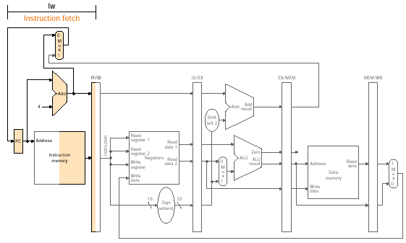
Pipelined Execution of Load Instruction
Pipeline

Slide 36
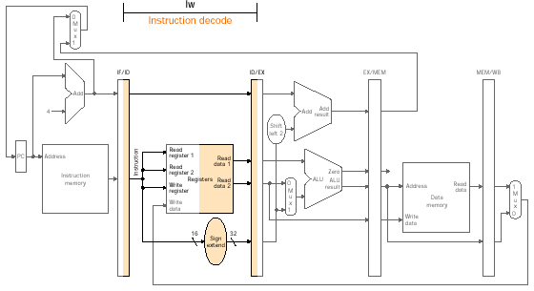
Pipelined Execution of Load Instruction
Pipeline

Slide 37
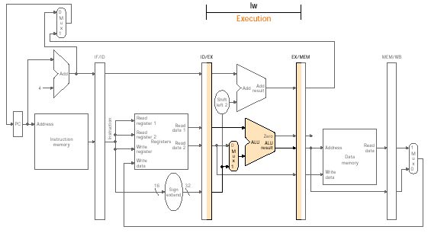
Pipelined Execution of Load Instruction
Pipeline

Slide 38
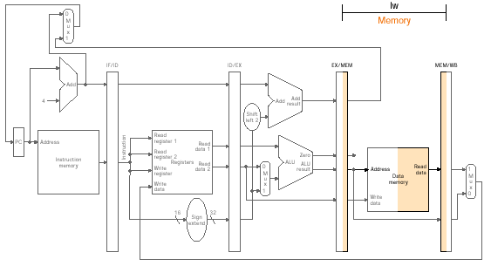
Pipelined Execution of Load Instruction
Pipeline

Slide 39
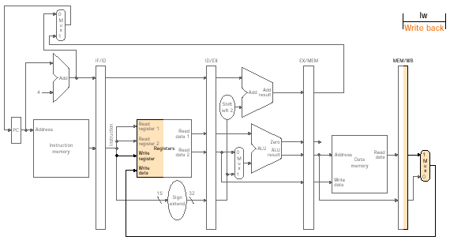
Pipelined Execution of Load Instruction
Pipeline

Slide 40
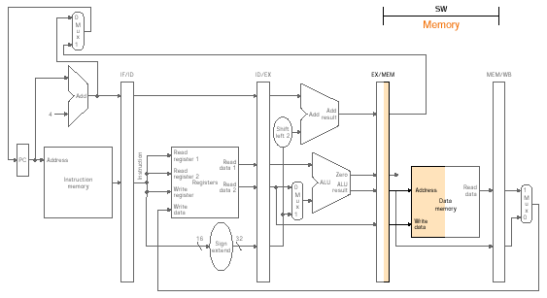
Pipelined Execution of Store Instruction
Pipeline

Slide 41
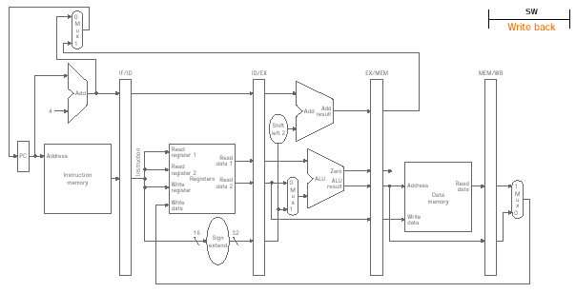
Pipelined Execution of Store Instruction
Pipeline

Slide 42
Observations from Load and Store
Pass information needed from an earlier stage to a latter stage
Each logical component of the datapath – such as IM, Reg read ports, ALU, DM, Reg write port – can be used only within a single pipeline stage. Otherwise, we would have structural hazard
A bug in the pipelined datapath for load. Can you tell?
Pipeline

Slide 43
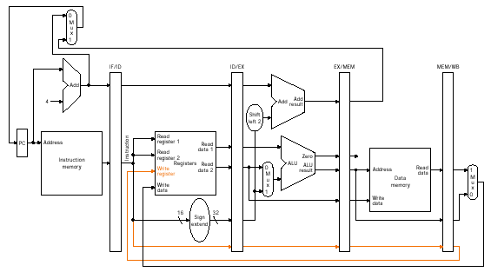
Modified Datapath
For basic R-Type, LW/SW, and BEQ
Pipeline

Slide 44
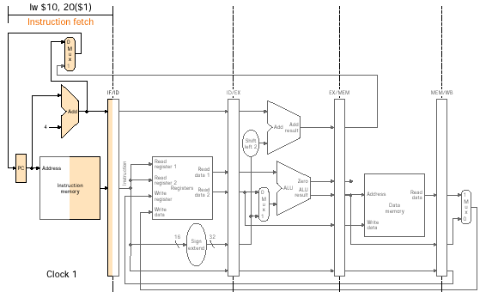
Pipelined Execution for Multiple Instr.
Pipeline

Slide 45
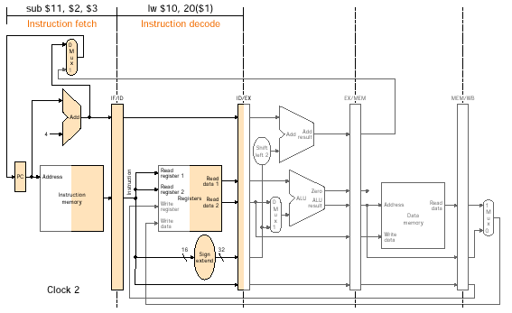
Pipelined Execution for Multiple Instr.
Pipeline

Slide 46
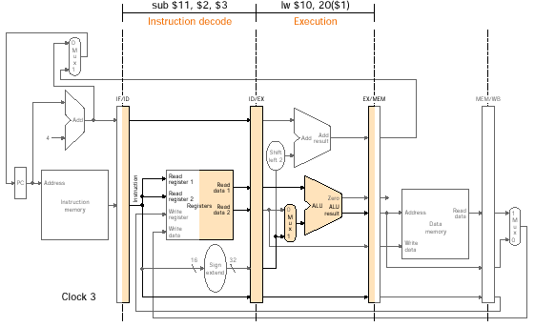
Pipelined Execution for Multiple Instr.
Pipeline

Slide 47
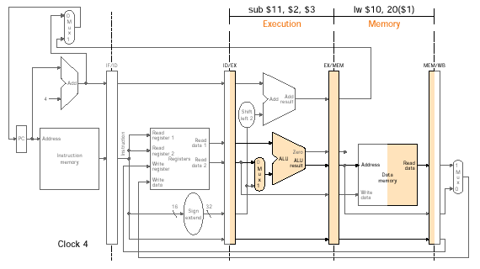
Pipelined Execution for Multiple Instr.
CS465
Pipeline

Slide 48
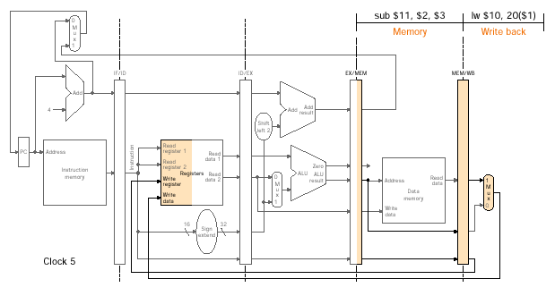
Pipelined Execution for Multiple Instr.
Pipeline

Slide 49
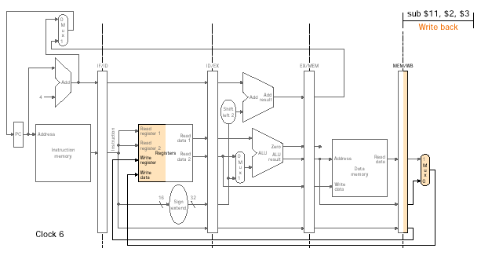
Pipelined Execution for Multiple Instr.
Pipeline

Slide 50
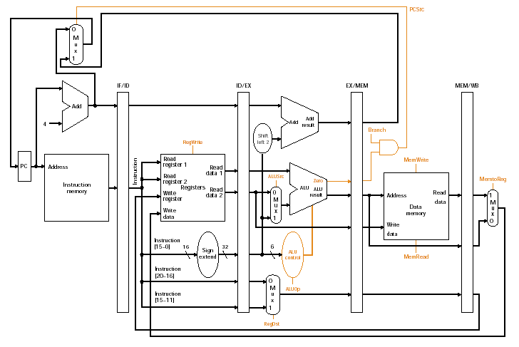
Pipelined Datapath Control
Fig. 6.22
Pipeline

Slide 51
Overview on Datapath Control
op
00 0000
00 1101
10 0011
10 1011
00 0100
00 0010
R-type
ori
lw
sw
beq
jump
RegDst
1
0
0
x
x
x
ALUSrc
0
1
1
1
0
x
MemtoReg
0
0
1
x
x
x
RegWrite
1
1
1
0
0
0
MemWrite
0
0
0
1
0
0
Branch
0
0
0
0
1
0
Jump
0
0
0
0
0
1
ExtOp
x
0
1
1
x
x
ALUop
“R-type”
Or
Add
Add
Subtract
xx
For the subset of instructions under consideration
  ALUOp = 00 for Add, 01 for Sub, and 10 for R-type
Pipeline

Slide 52
Observations
No write control for all pipeline registers and PC since they are updated at every clock cycle
To specify the control for the pipeline, set the control values during each pipeline stage
Control lines can be divided into 5 groups:
  IF – NONE
  ID – NONE
  ALU – RegDst, ALUOp, ALUSrc
  MEM – Branch, MemRead, MemWrite
  WB – MemtoReg, RegWrite
Group these nine control lines into 3 subsets:
  ALUControl, MEMControl, WBControl
Control signals are generated at ID stage, how to pass them to other stages?
Pipeline

Slide 53
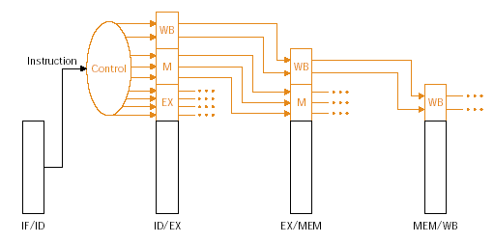
Pass Control Signals
Extend the pipeline registers to include control information
Pipeline

Slide 54
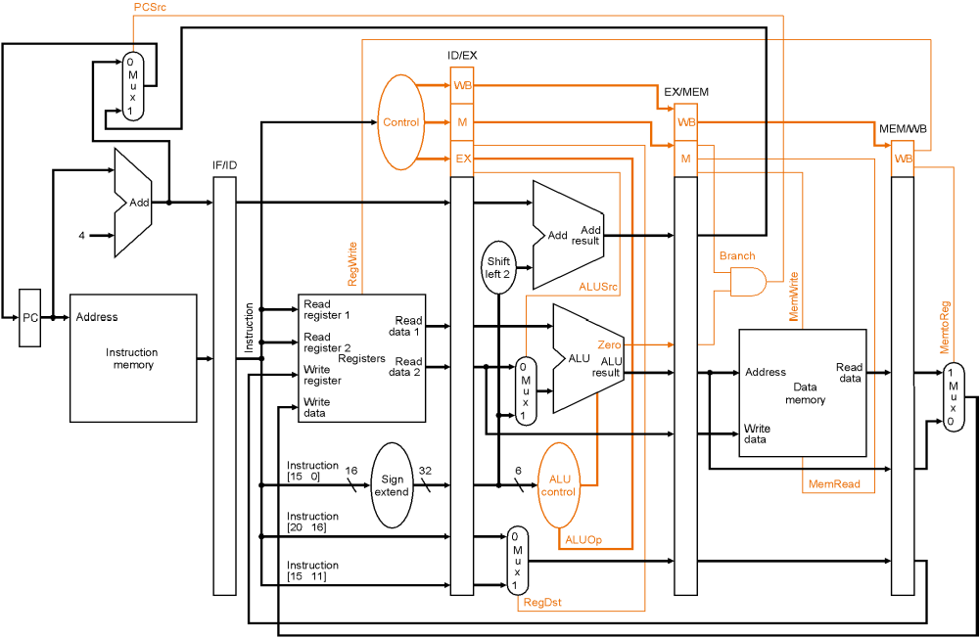
The Complete Pipelined Datapath
Fig 6.27
Pipeline

Slide 55
Example Pipeline Execution
Show the five instructions going through the pipeline:
lw $10, 20($1)
sub $11, $2, $3
and $12, $4, $5
or $13, $6, $7
add $14, $8, $9
Note that these instructions are independent from each other!
Pipeline

Slide 56
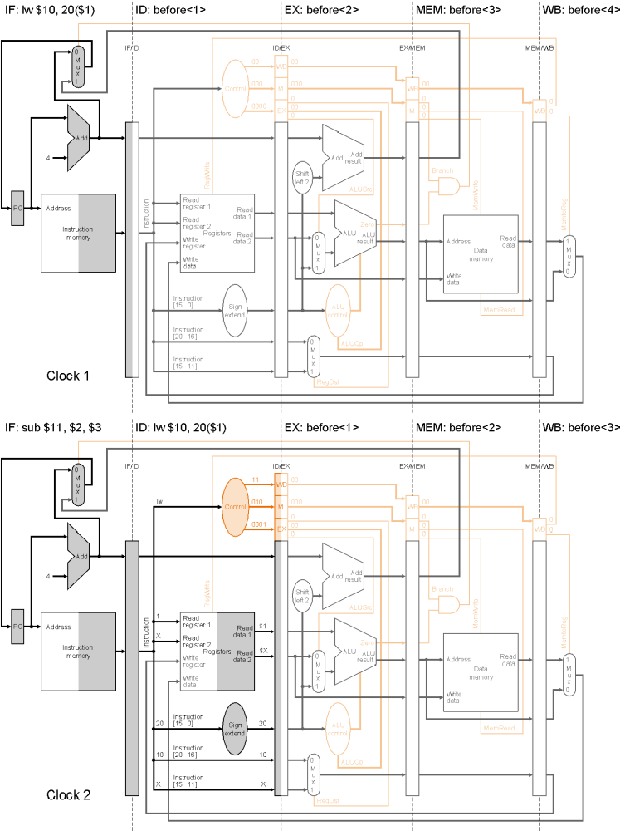
Clock1
CS465
Pipeline

Slide 57
Clock2
CS465
Pipeline

Slide 58
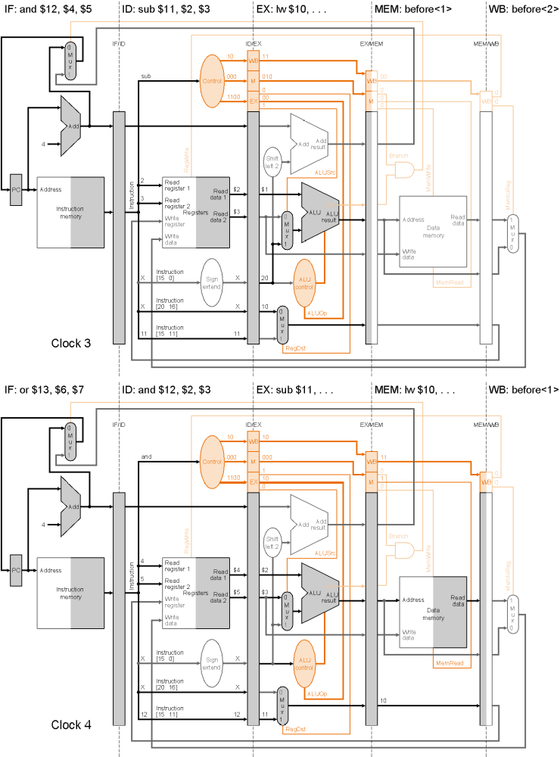
Clock3
CS465
Pipeline

Slide 59
Clock4
Pipeline

Slide 60
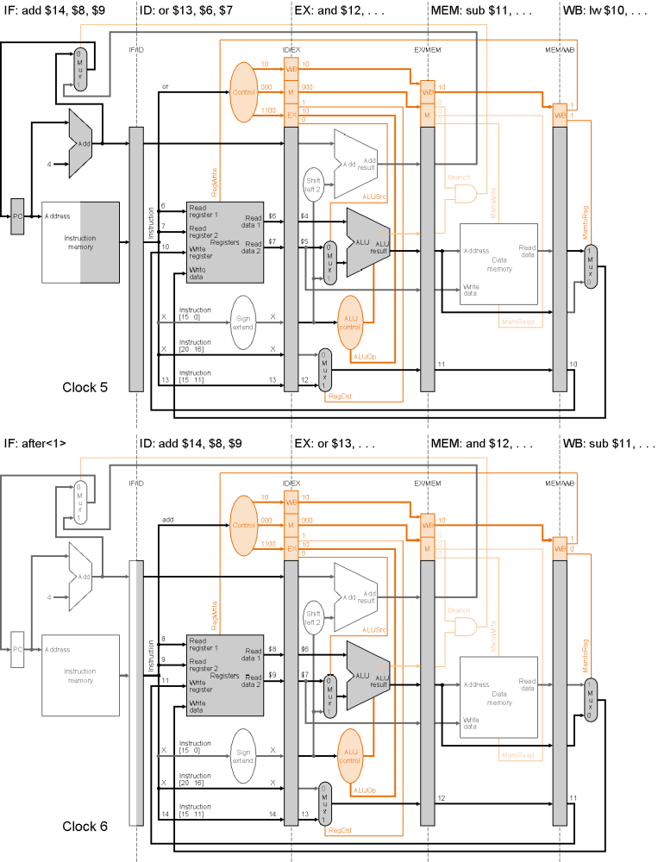
Clock5
CS465
Pipeline

Slide 61
Clock6
Pipeline

Slide 62
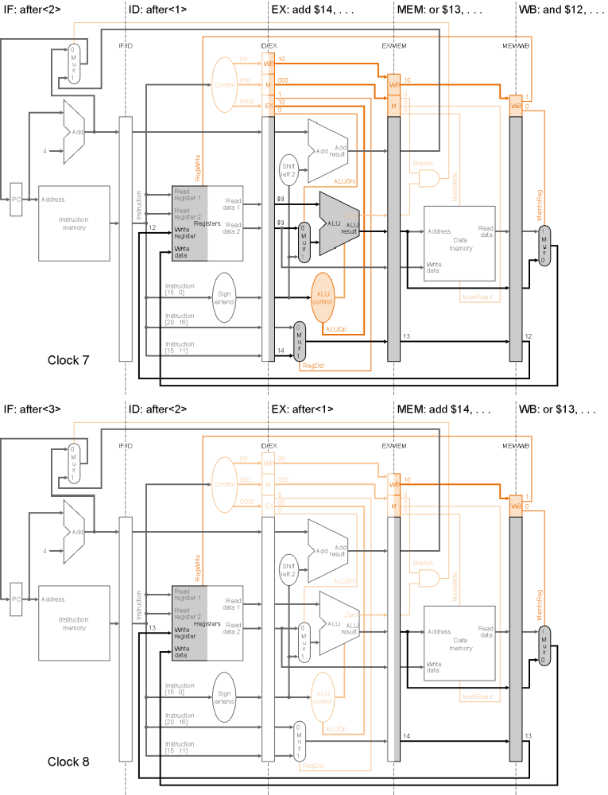
Clock7
CS465
Pipeline

Slide 63
Clock8
CS465
Pipeline

Slide 64
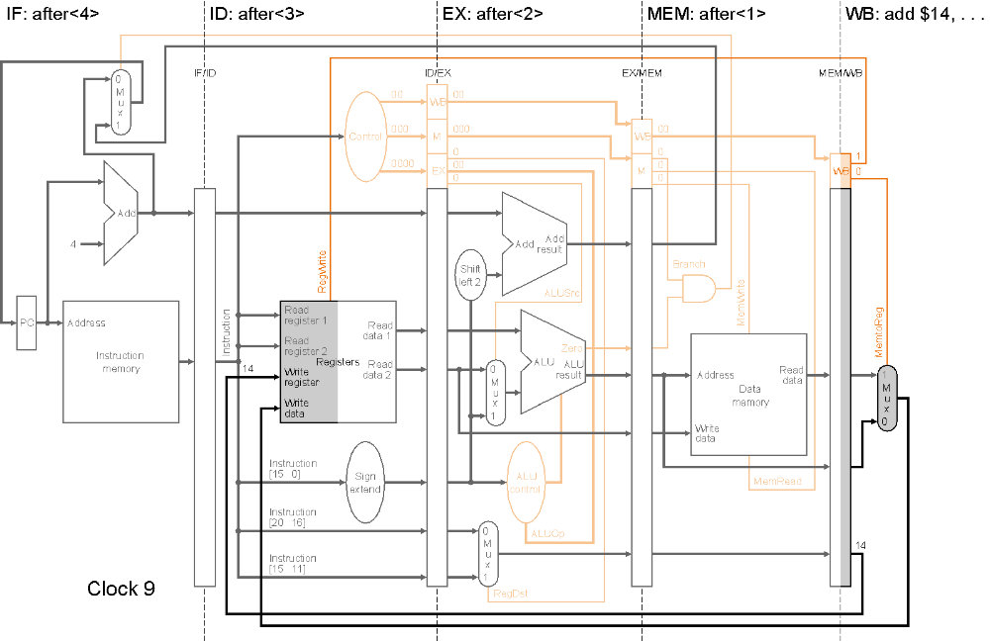
Clock9
Pipeline

Slide 65
Summary
Overview of pipeline
  Stages
  Hazards
Pipelined datapath
  Pipeline registers
  Pipelined execution
Pipelined control
  Different signals for different stages
  Propagate control signals
Pipeline

Slide 66
Next Lecture
Topic:
  Pipeline hazards and solutions
  Exception handling
Reading
  Patterson & Hennessy Ch6.4-6.9
Pipeline

